Slide 1
Softwares

Slide 2
System Software, Application Software and Driver Programs
System Software- Performs essential operation tasks
Operating system
Utility programs (A program that performs a very specific task, usually related to managing system resources)i.e disk cleaner, antivirus, screen savers
Application Software - Performs specific tasks for users
Business application
Communications application
Multimedia application
Entertainment and educational software
Driver Programs (Device Driver)
small program that allows a specific input or output device to communicate with the rest of the computer system

Slide 3
3 type of programs
user / application programs
programs used by the users to perform a task
system programs
an interface between user and computer
driver programs
communicate I/O devices with computer

Slide 4
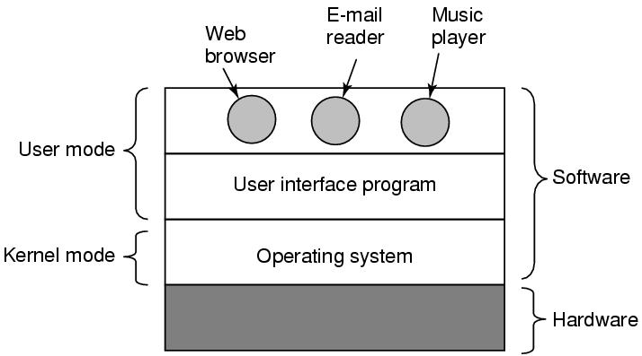
Where does the OS fit in?

Slide 5
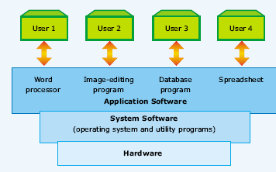
Hierarchy of computer software

Slide 6
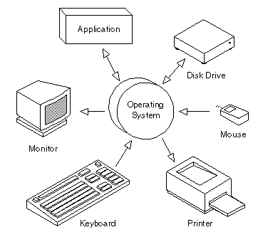
Definition
An Operating System, or OS, is low-level software that enables a user and higher-level application software to interact with a computer’s hardware and the data and other programs stored on the computer.
An OS performs basic tasks, such as recognizing input from the keyboard, sending output to the display screen, keeping track of files and directories on the disk, and controlling peripheral devices such as printers.

Slide 7
Basic functions of the operating system
Device configuration
Controls peripheral devices connected to the computer
File management
Transfers files between main memory and secondary storage, manages file folders, allocates the secondary storage space, and provides file protection and recovery
Operating
System
Memory management
Allocates the use of random access memory (RAM) to requesting processes
Interface platform
Allows the computer to run other applications

Slide 8
Operating Systems functions:
The main functions of operating systems are:
Program creation
Program execution
Input/Output operations
Error detection
Resource allocation
Accounting
protection

Slide 9
Other function of Operating System
best use of the computer resources
provide a background for user’s programs to execute
display and deal with errors when it happens
control the selection and operation of the peripherals
act as a communication link between users
system protection

Slide 10
Common Operating Systems
Network Operating System
UNIX / Linux / MS Windows2000 Server
Desktop Operating System
MS Windows 9X/Me / Mac OS / DOS
Mobile Operating System
Palm OS and Pocket PC

Slide 11
Examples
Common operating systems
WINDOW
used in IBM compatible microcomputers
UNIX
multi-user, multi-tasking OS used in minicomputers and microcomputers
VAX/VMS
used in DEC’s VAX series of minicomputers

Slide 12
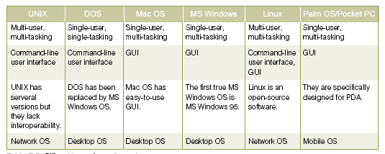
Different Types of Operating System

Slide 13
Good Operating System
efficient
time spent to execute its programs should be short
small in size
memory occupied should be as small as possible
reliable

Slide 14
Type of Operating System
Batch processing
Real time processing
Time sharing processing

Slide 15
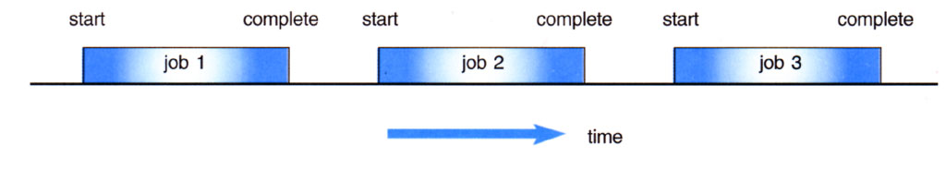
Batch processing
Jobs, together with input data, are fed into the system in a batch.
The jobs are then run one after another.
No job can be started until previous job is completed

Slide 16
Real time processing
immediate response is needed.
For example
anti-missile defense system
airplane landing control system
interrupt error in computer system

Slide 17
Time sharing processing
Each user is given a time slice to interact with the CPU.
The size of the time slice will depend on the system.
Each user is served in sequence.

Slide 18
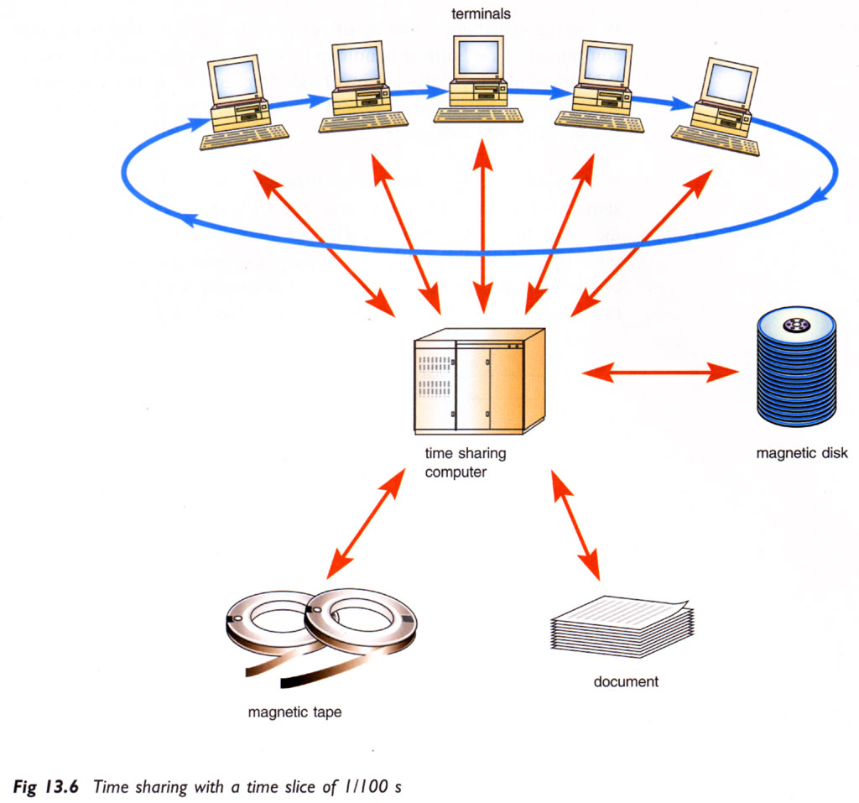

Slide 19
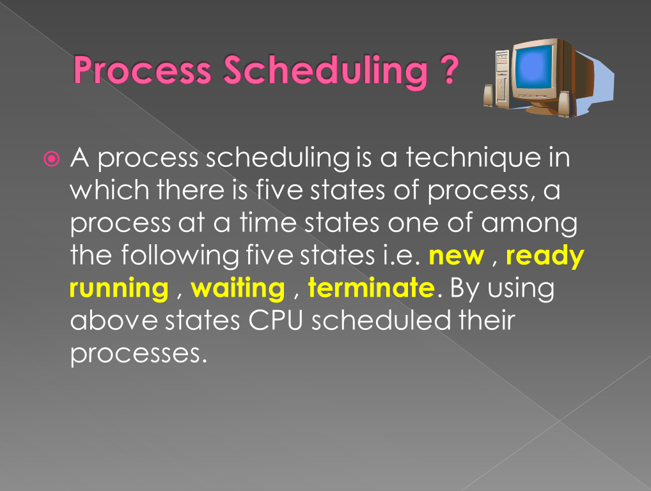

Slide 20
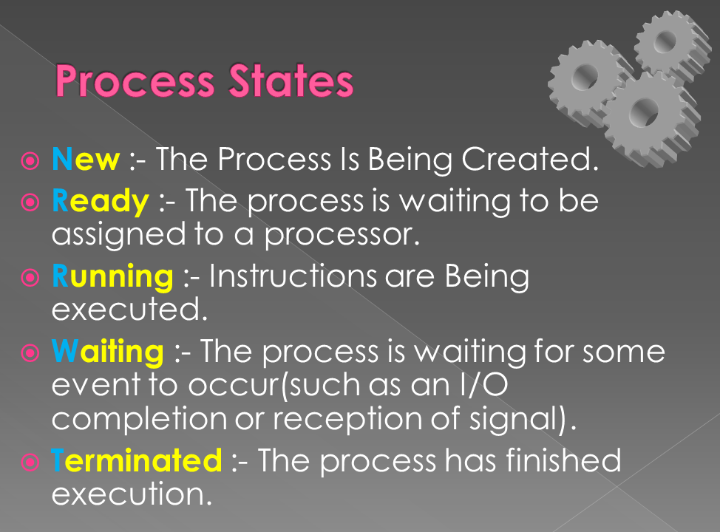

Slide 21
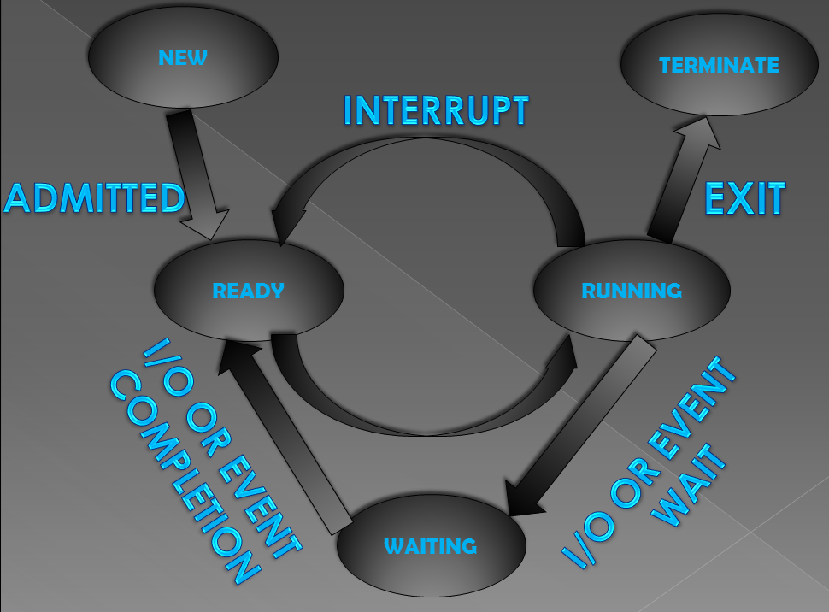

Slide 22

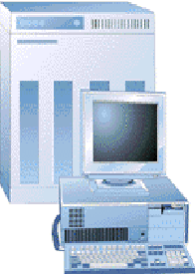
Role of Systems Software
System software…
Is an interface or buffer between application software and hardware
Controls the computer hardware and acts as an interface with applications programs
Application software
Operating and systems software
Users
Hardware

Slide 23
Systems Software
Hardware independence
Operating system (OS) provides hardware independence for application software
Application software interfaces with the operating system which interfaces with the hardware
When the hardware is changed, the operating system is changed so that the application software is not required to be changed

Slide 24
Software Concepts
Memory management
Multitasking
Multithreading
Timesharing

Slide 25
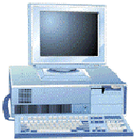
Memory Management
Memory management…
Controls how memory is accessed and maximizes available memory and storage
Application Software
OS
What is the price of TIBA35 (TIBA35$)
Fetch TIBA35$ from hard disk, track 1, sector 7
TIBA35$

Slide 26
Multitasking, Multithreading, Time-sharing
Multitasking
A processing activity that allows a user to run more than one application at the same time
Multithreading
A processing activity that is basically multitasking within a single application
Time-sharing
A processing activity that allows more than one person to use a computer system at the same time

Slide 27
Software Concepts
Network capability
Aids in connecting the computer to a network
Access to system resources
Provides security for unauthorized access
File management
Ensures that files in secondary storage are available when needed, and they are protected against unauthorized usage

Slide 28
Utility Programs
Utility programs…
Programs used to merge and sort sets of data, keep track of computer jobs being run, compress files of data before they are stored or transmitted over a network, and perform other important tasks

Slide 29
Types of Application Software
Proprietary
Designed to solve a unique and specific problem
In-house
Development of application software using the company’s resources
Contract
Developed for a particular company
Off-the-shelf
An existing software program that can be used without considerable changes expected

Slide 30
Customized package
Blend of external and internal software development
In-house customized
Contract customization

Slide 31
Storage Structure
Main memory – only large storage media that the CPU can access directly
Programs and data cannot reside in main memory permanently because:
Main memory is limited (too small) to store all programs and data permanently
Main memory is volatile
So secondary storage is provided – extension of main memory that provides large nonvolatile storage capacity
Magnetic disks – rigid metal or glass platters covered with magnetic recording material
Disk surface is logically divided into tracks, which are subdivided into sectors
The disk controller determines the logical interaction between the device and the computer

Slide 32
Storage Hierarchy
Storage systems organized in hierarchy by
Speed
Cost
Volatility
The higher levels in the hierarchy are expensive but fast. As we move down the hierarchy, the cost per bit generally decreases, whereas the access time generally increases.
Caching – copying information into faster storage system; main memory can be viewed as a last cache for secondary storage

Slide 33
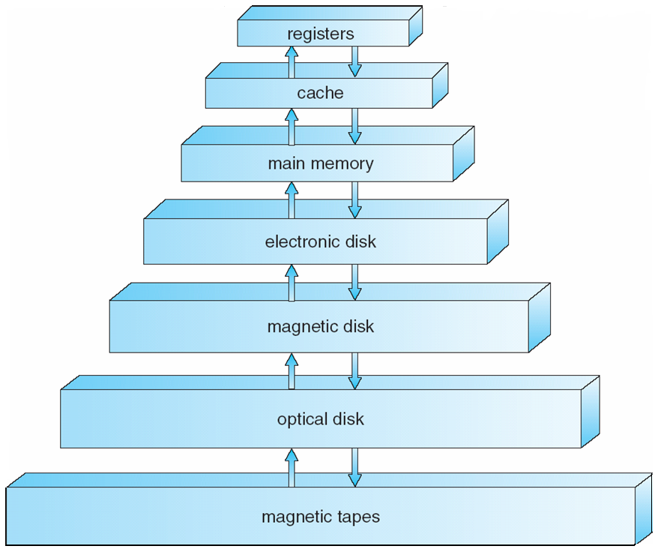
Storage-Device Hierarchy

Slide 34
Caching
Important principle, performed at many levels in a computer (in hardware, operating system, software)
Information in use copied from slower to faster storage temporarily
Faster storage (cache) checked first to determine if information is there
If it is, information used directly from the cache (fast)
If not, data copied to cache and used there
Cache smaller than storage being cached
Cache management important design problem
Cache size and replacement policy

Slide 35
Computer-System Architecture
Most systems use a single general-purpose processor
Most systems have special-purpose processors as well
Multiprocessors systems growing in use and importance
Also known as parallel systems, tightly-coupled systems
Advantages include
Increased throughput
Economy of scale
Increased reliability – graceful degradation or fault tolerance
Two types
Asymmetric Multiprocessing
Symmetric Multiprocessing

Slide 36
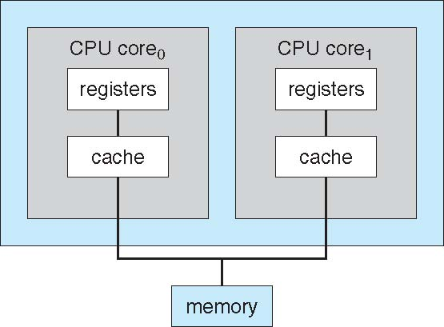
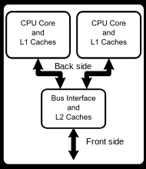
A Dual-Core Design

Slide 37
Operating System Structure
Multiprogramming needed for efficiency
Single user cannot keep CPU and I/O devices busy at all times
Multiprogramming organizes jobs (code and data) so CPU always has one to execute
A subset of total jobs in system is kept in memory
One job selected and run via job scheduling
When it has to wait (for I/O for example), OS switches to another job

Slide 38
Operating System Structure (Cont.)
Timesharing (multitasking) is logical extension in which CPU switches jobs so frequently that users can interact with each job while it is running, creating interactive computing
Response time should be < 1 second
Each user has at least one program executing in memory process
If several jobs ready to run at the same time  CPU scheduling
If processes don’t fit in memory, swapping moves them in and out to run
Virtual memory allows execution of processes not completely in memory

Slide 39
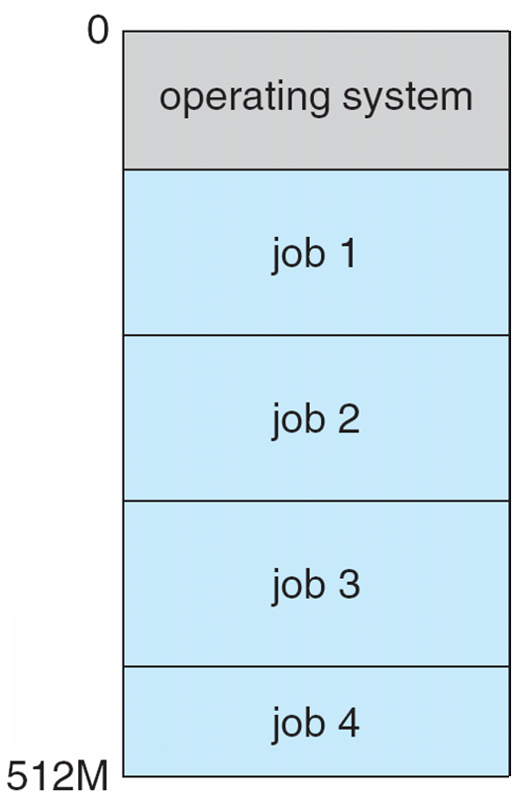
Memory Layout for Multiprogrammed System

Slide 40
Operating-System Operations
Interrupt driven by hardware
Software error or request creates exception or trap
Division by zero, request for operating system service
Other process problems include infinite loop, processes modifying each other or the operating system
Dual-mode operation allows OS to protect itself and other system components
User mode and kernel mode
Mode bit provided by hardware
Provides ability to distinguish when system is running user code or kernel code
Some instructions designated as privileged, only executable in kernel mode
System call changes mode to kernel, return from call resets it to user

Slide 41
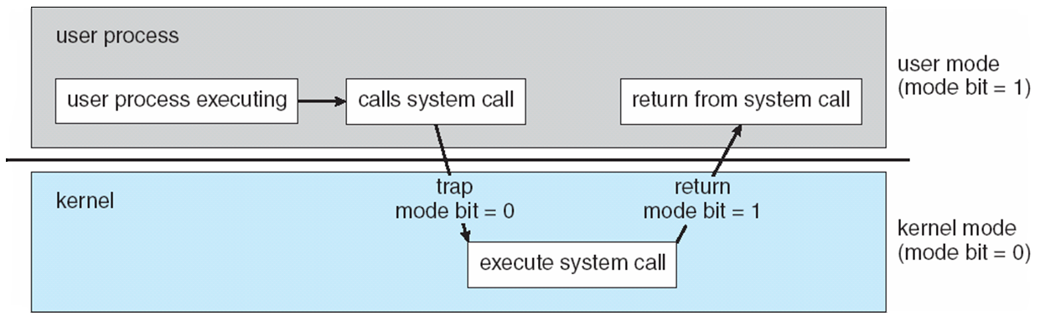
Transition from User to Kernel Mode
Timer to prevent infinite loop / process hogging resources
Set interrupt after specific period
Operating system decrements counter
When counter zero generate an interrupt
Set up before scheduling process to regain control or terminate program that exceeds allotted time

Slide 42
Process Management
A process is a program in execution. It is a unit of work within the system. Program is a passive entity, process is an active entity.
Process needs resources to accomplish its task
CPU, memory, I/O, files
Initialization data
Process termination requires reclaim of any reusable resources
Single-threaded process has one program counter specifying location of next instruction to execute
Process executes instructions sequentially, one at a time, until completion
Multi-threaded process has one program counter per thread
Typically system has many processes, some user, some operating system running concurrently on one or more CPUs
Concurrency by multiplexing the CPUs among the processes / threads

Slide 43
Process Management Activities
The operating system is responsible for the following activities in connection with process management:
Creating and deleting both user and system processes
Suspending and resuming processes
Providing mechanisms for process synchronization
Providing mechanisms for process communication
Providing mechanisms for deadlock handling

Slide 44
Memory Management
All data in memory before and after processing
All instructions required in memory in order to execute
Memory management activities
Keeping track of which parts of memory are currently being used and by whom
Deciding which processes (or parts thereof) and data to move into and out of memory
Allocating and deallocating memory space as needed

Slide 45
Storage Management
OS provides uniform, logical view of information storage
Abstracts physical properties to logical storage unit - file
Each medium is controlled by device (i.e., disk drive, tape drive)
Varying properties include access speed, capacity, data-transfer rate, access method (sequential or random)
File-System management
Files usually organized into directories
Access control on most systems to determine who can access what
OS activities include
Creating and deleting files and directories
Primitives to manipulate files and directories
Mapping files onto secondary storage
Backup files onto stable (non-volatile) storage media

